Slide 1


CSS (Cascading Style Sheet)
Notes:
Get connected
Self introduction
Engagement questions
Will have gifts if you can answer questions
——
How many of you didn’t know HTML/CSS before?
How many of you already know HTML/CSS?
How many of you never heard about HTML/CSS?

Slide 2

Find reasons to support your goal!!!
https://financesonline.com/tips-writing-goals-increase-productivity-work/

Slide 3
Agenda
Why CSS?
How to add CSS?
CSS Selectors
Box model
Common properties
Q & A

Slide 4

Why CSS?

Slide 5
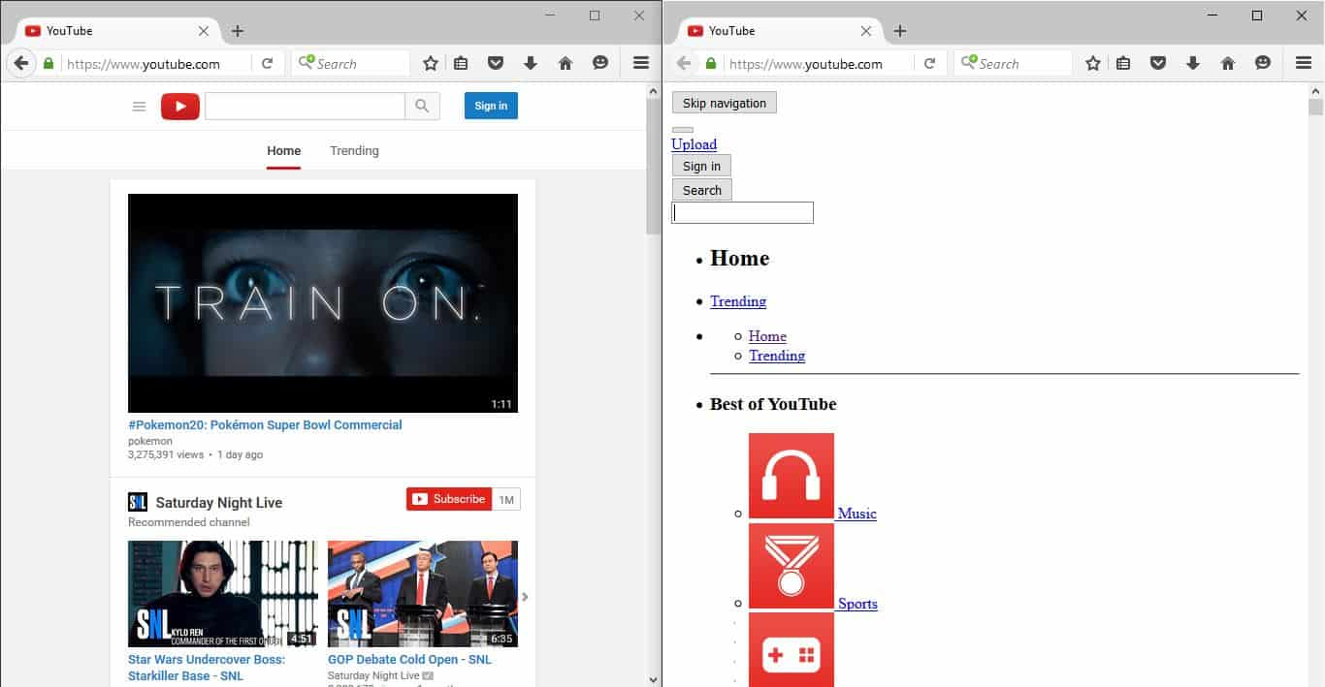
Why CSS?

Slide 6
How many ways to insert CSS?
Notes:
Disable html tat css
Co 3 cach them css

Slide 7
Three ways to insert CSS
Inline Use style attribute in the open tag
Internal Put inside a style tag
External Put in an external css file

Slide 8
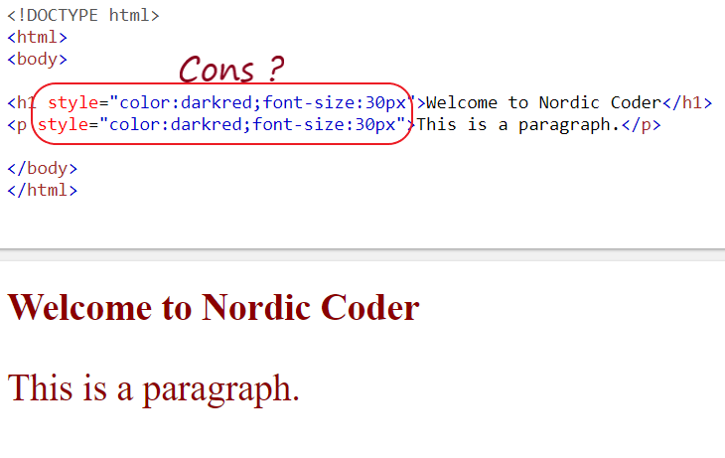
Inline CSS
Notes:
Title—red
Title
Thuong dung External CSS

Slide 9
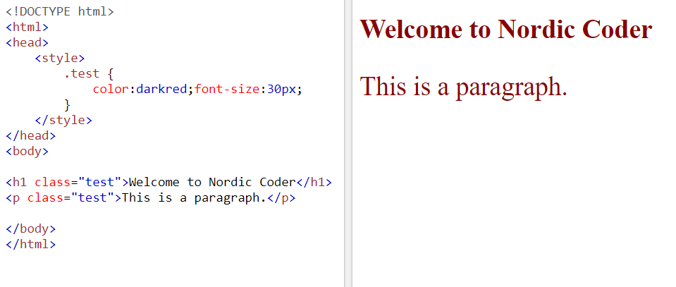
Internal CSS

Slide 10
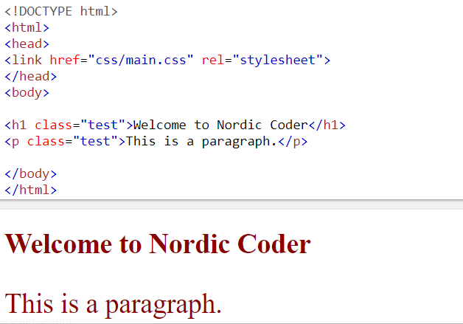
External CSS

Slide 11
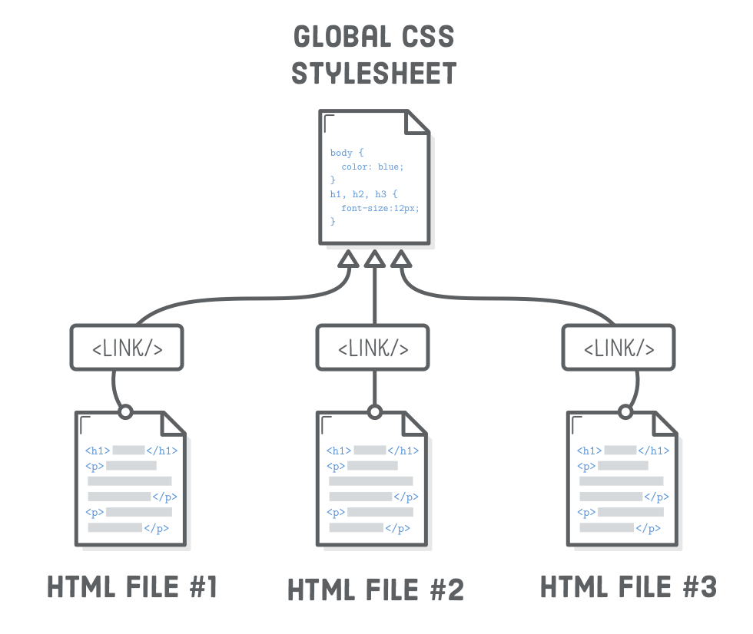

Slide 12
Practice
Three ways to add CSS

Slide 13

CSS Syntax

Slide 14
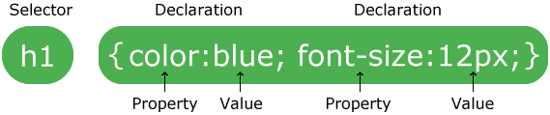
CSS Syntax

Slide 15
CSS Selectors

Slide 16
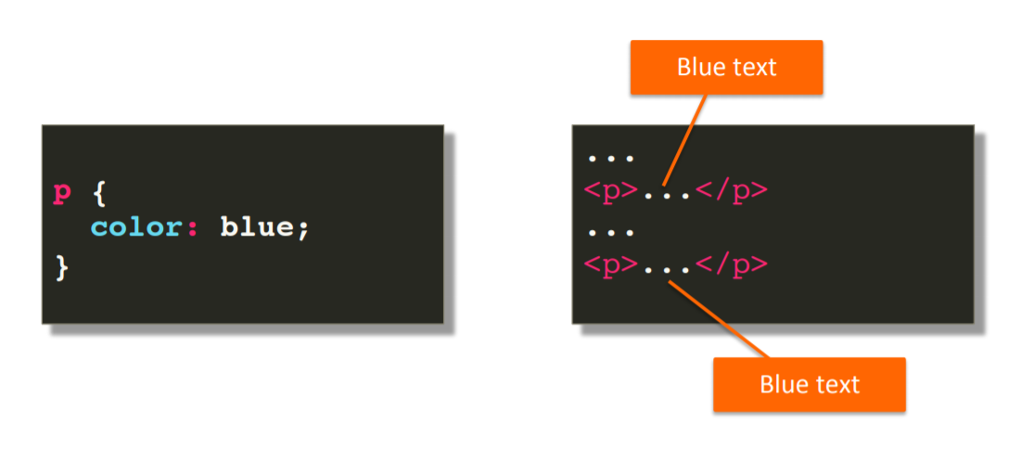
CSS Selector - Tag

Slide 17
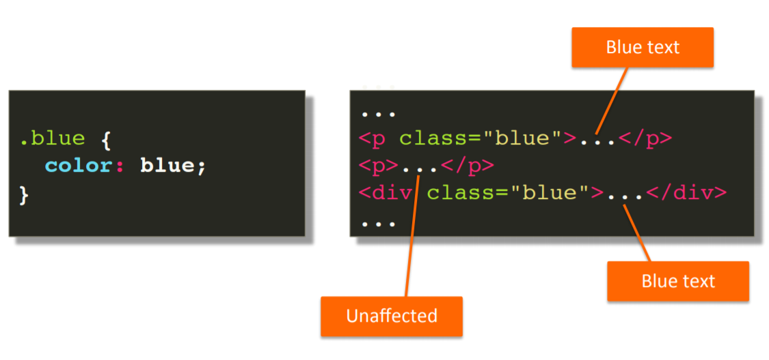
CSS Selector - Class

Slide 18
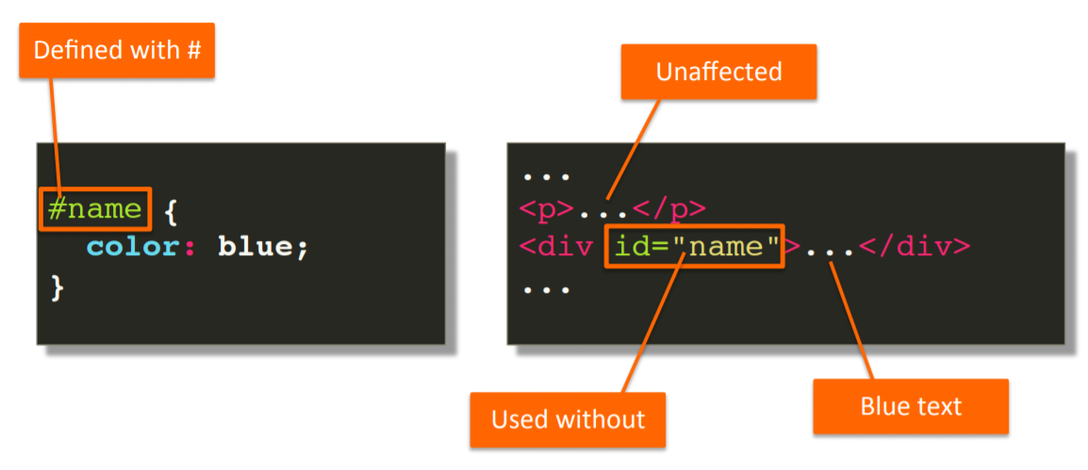
CSS Selector - ID

Slide 19
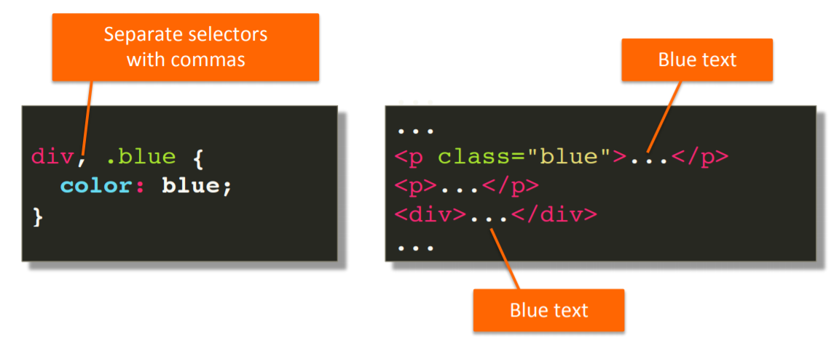
CSS Selector - Grouping

Slide 20
Practice
CSS Selectors

Slide 21
Combinators
(combining selectors)

Slide 22
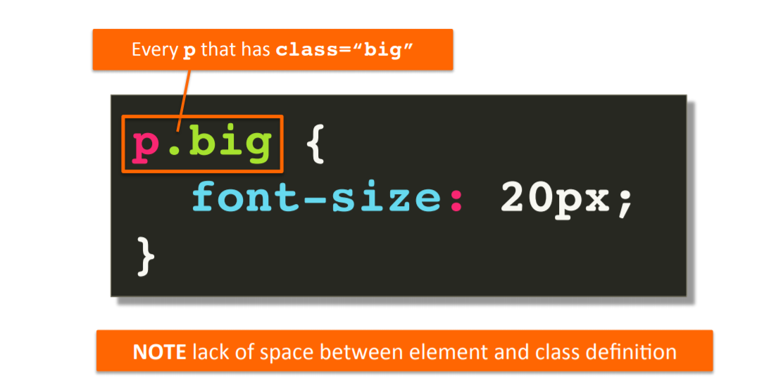
Element with class selector

Slide 23
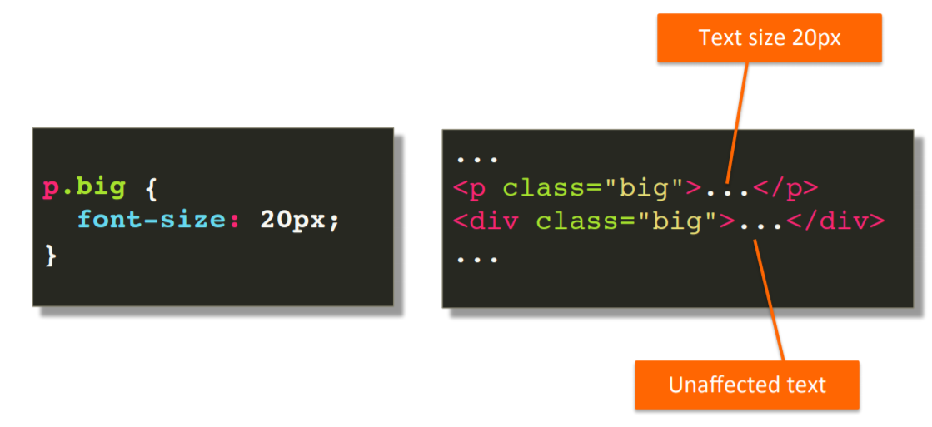
Element with class selector

Slide 24
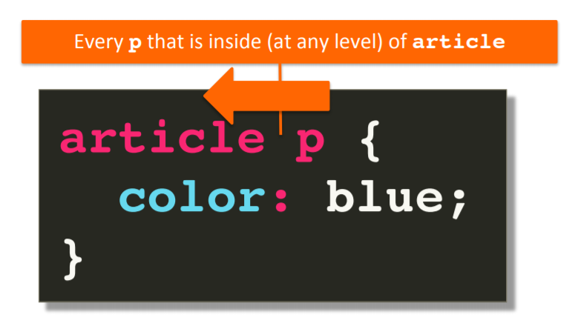
Descendant selector
Notes:
Tat ca the p nam trong article ap dung thuoc tinh nay
article.class p

Slide 25
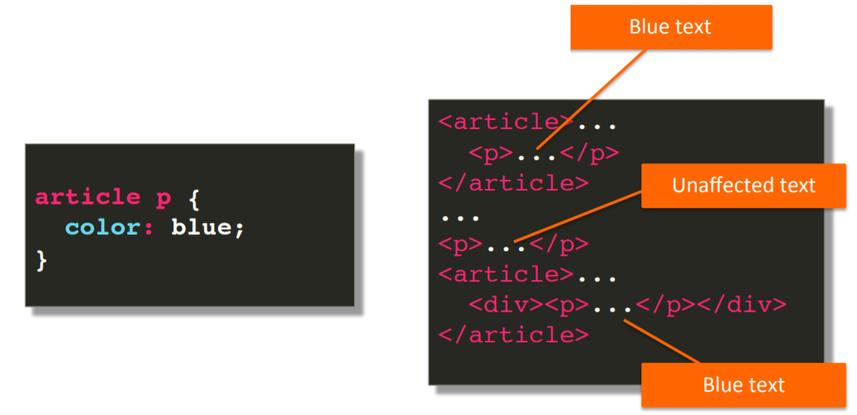
Descendant selector

Slide 26
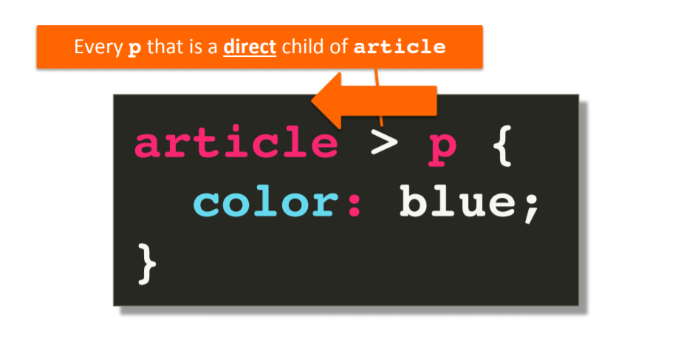
Child selector
Notes:
Con truc tiep chi ap dung no

Slide 27
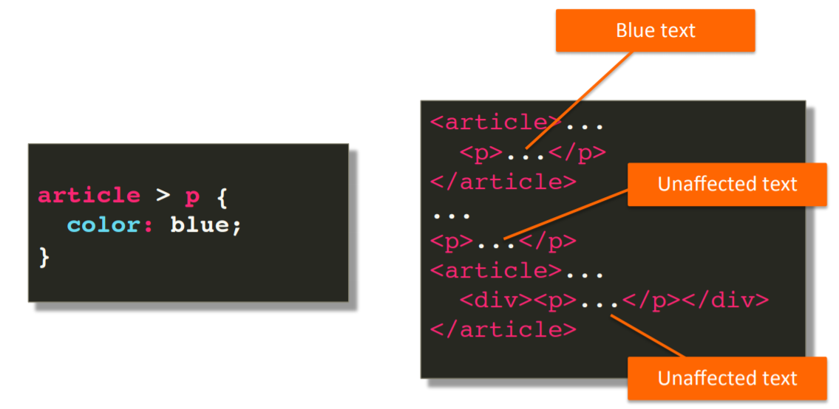
Child selector

Slide 28
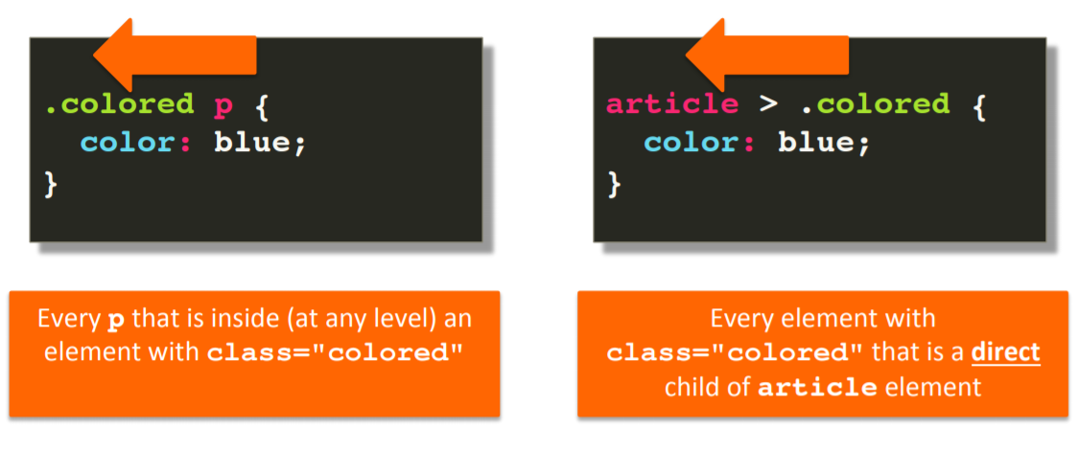
Child and Descendant

Slide 29
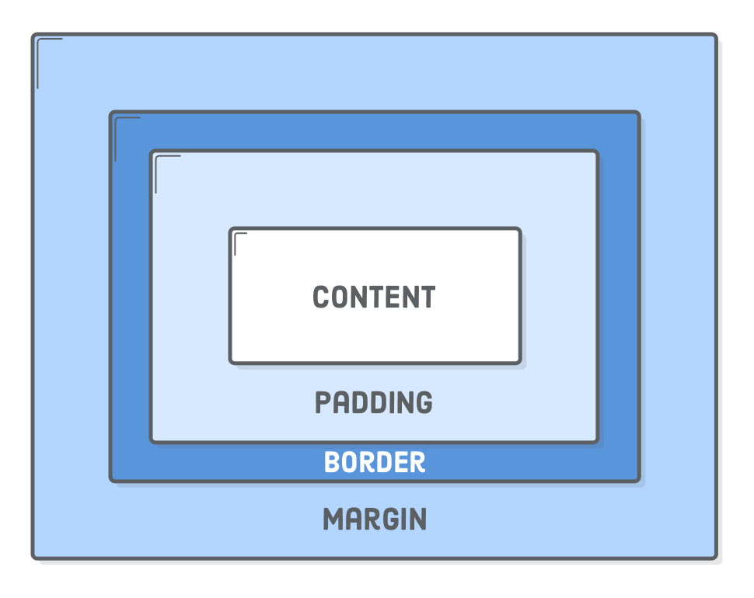
Box model
Notes:
Padding khoan cach giua content border
Margin khoan cach giua item, element, button

Slide 30
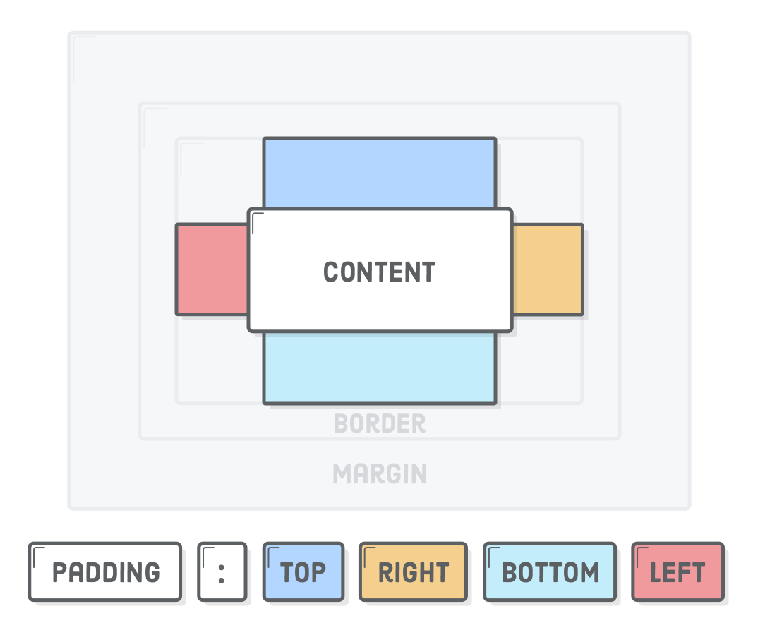
Margin, Padding property
Notes:
Padding: 8px 16px 8px 16px

Slide 31
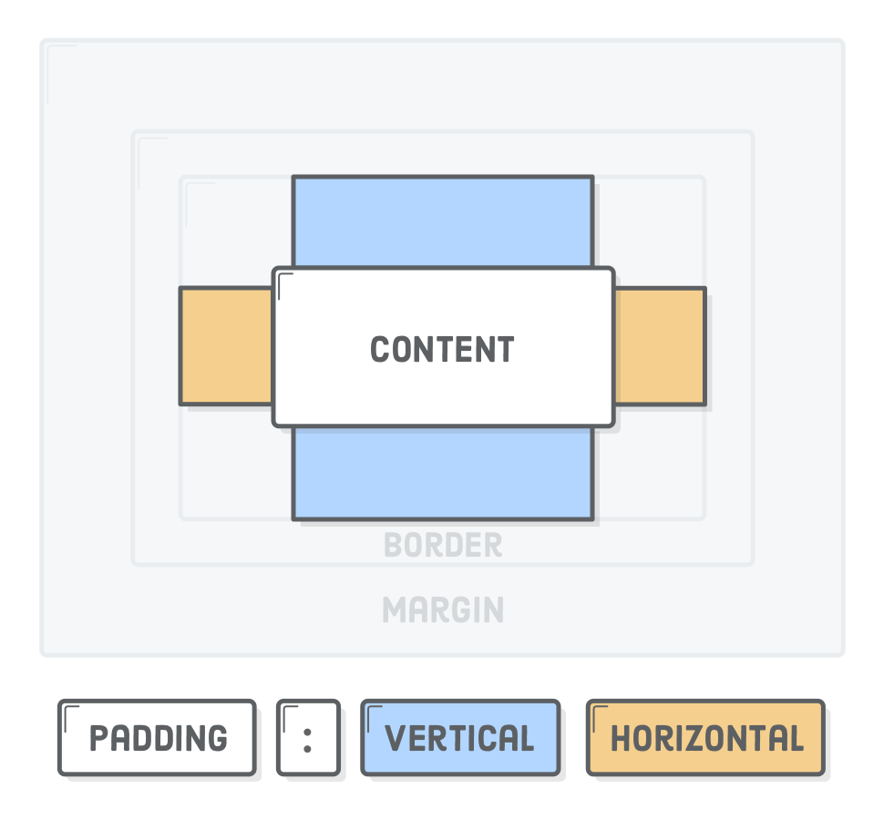
Shorthand format
Notes:
Margin:8px 16px ( tren duoi + trai phai)

Slide 32
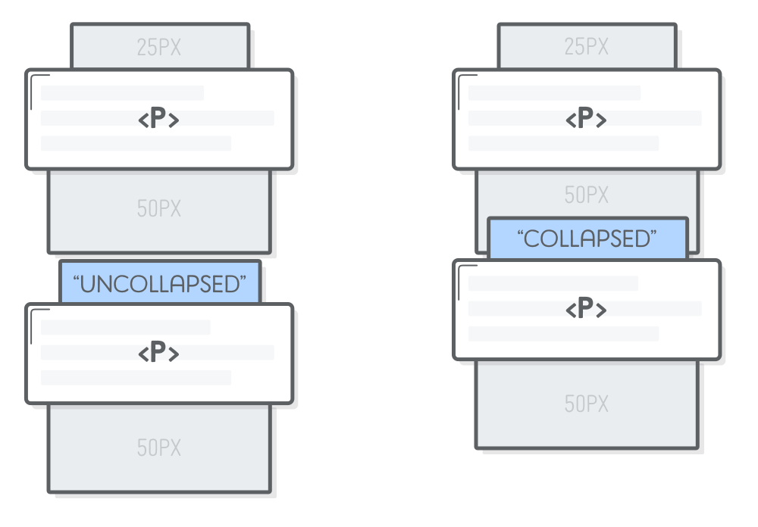
Margin collapsed

Slide 33
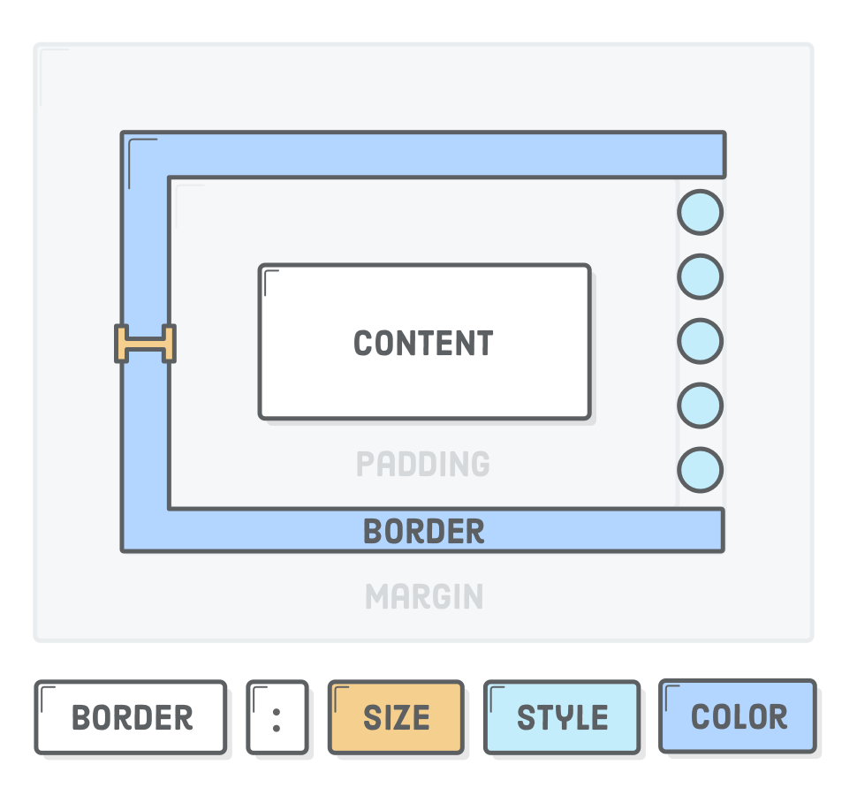
Border
Notes:
Size thuong dung 1px
Style = solid
Mau den #000

Slide 34
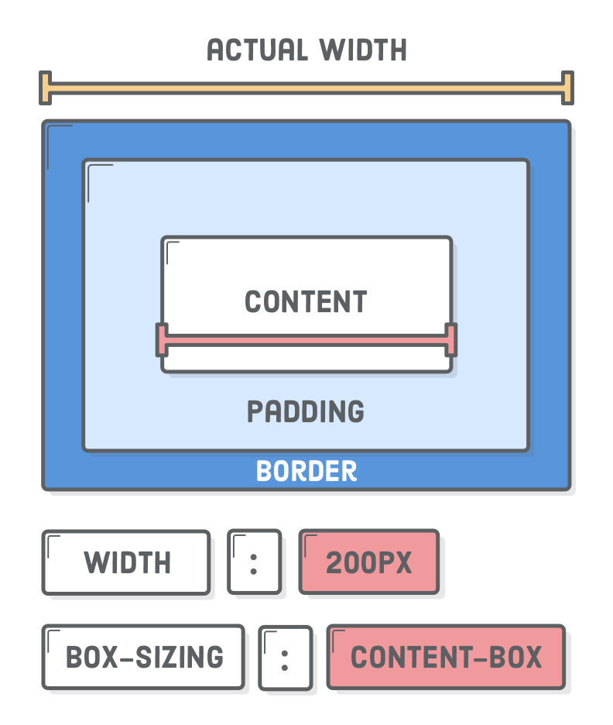
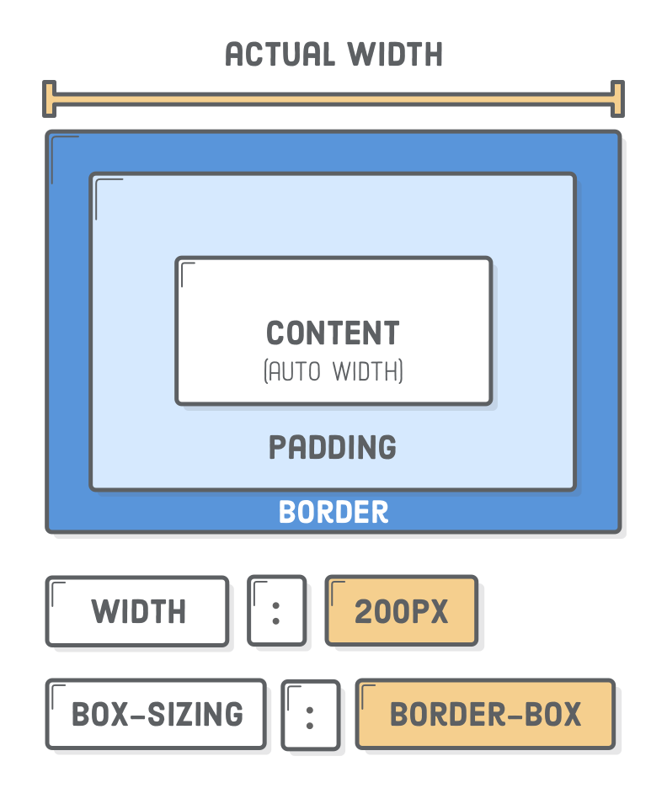
Box sizing
Notes:
Content-box: phu thuoc padding +border, width chi dinh cho duy nhat content
Border-box: width qui dinh nguyen doi tuong luon

Slide 35
CSS Properties

Slide 36
Common used properties
Property | Property
width | box-shadow
height | cursor
padding | display
margin | position
border | top, left, bottom, right
border-radius | …
https://css-tricks.com/poll-results-how-do-you-order-your-css-properties/
Notes:
Border-radius: do cong vieng

Slide 37
Background
Property | Description
background | Short hands to set all properties
background-size | Specifies the size of the background image
background-repeat | Will the background image be repeated?
background-position | Sets the starting position of a background img
background-image | Set the background image for an element
background-color | Sets the background color of an element

Slide 38
Text
Property | Description
color | Short hands to set all properties
line-height | Specifies the size of the background image
text-align | Will the background image be repeated?
text-transform | Sets the starting position of a background img

Slide 39
Font
Property | Description
font | Short hands to set all properties
font-family | Specifies the font family for text
font-size | Specifies the font size of text
font-style | Specifies the font style for text
font-weight | Specifies the weight of a font
font-variant | Specifies whether or not a text should be displayed in a small-caps font

Slide 40
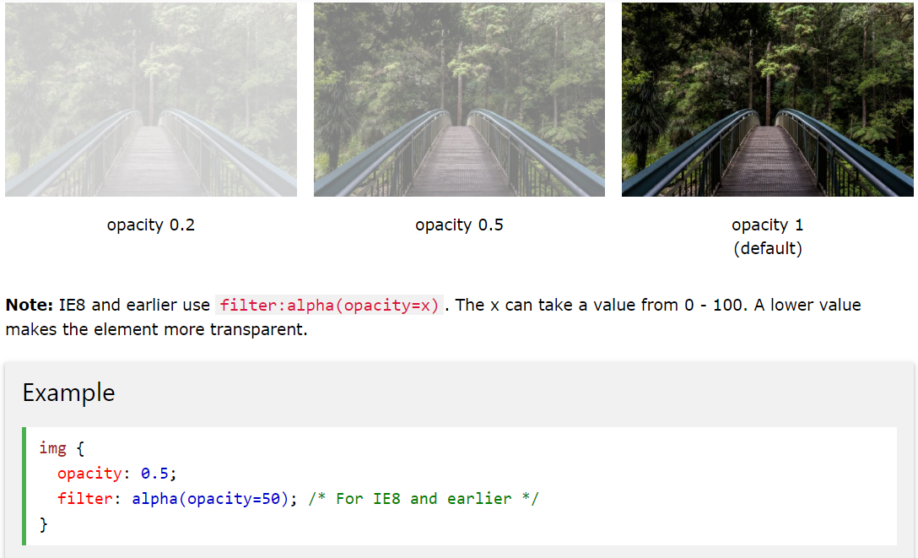
Opacity

Slide 41


Slide 42
Lab
Try to style a paragraph in three ways
Add styles for simple profile
Week 2 assignment hints

Slide 43
Refs
https://www.w3schools.com/css/default.asp
https://internetingishard.com/html-and-css/hello-css/
https://internetingishard.com/html-and-css/css-box-model/
https://internetingishard.com/html-and-css/css-selectors/

Slide 44


Slide 45


Slide 46


Slide 47

Thank You And see you ;)

